Slide 1
CH2PH2:
Chemical Kinetics
Dr. James Hallett
j.e.hallett@reading.ac.uk

Slide 2
Lecture 2
CH2PH2 Chemical Kinetics

Slide 3
the steady state approximation

Slide 4
Rules for determining the rate equation for a multi-step reaction (1)
We can break any reaction down to a series of one-step reactions.
Each single step – “elementary reaction” - follows simple kinetics.
For each elementary reaction, we can write the rate equation just from the chemical equation.
The order of the reaction is the same as the molecularity…

Slide 5
Rules for determining the rate equation for a multi-step reaction (2)
Many components will have elementary reactions that make them, and other elementary reactions that remove them.
Calculate the (overall) rate of change of each component:
  For each elementary reaction, add the rate if it makes that component. Subtract the rate if it removes that component.
  Don’t forget to multiply by the number of molecules of that component that the elementary reaction makes or removes.

Slide 6

Rules for determining the rate equation for a multi-step reaction (3)
Steady-state approximation
$$A\underset{→}{k_{1}}I\underset{→}{k_{2}}P$$
After a short initial period while the levels of intermediate I build up…
the rate of change of I is almost zero for most of the reaction.
Rate of formation of I = Rate of disappearance of I

Slide 7

The “bucket” analogy
(simple two-step reaction)
k₁ - size of hole
Reservoir A
$$A\underset{→}{k_{1}}I\underset{→}{k_{2}}P$$
[A]
k₁ x [A]: rate of water flowing into bucket
[I] : level of water in bucket
Bucket I
k₂ - size of hole
k₂ x [I]: rate of water flowing out of bucket
Pond

Slide 8
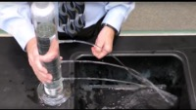
https://youtu.be/K5g6P8-GmBg?si=B9t98Ayz4bMaVML2

Slide 9
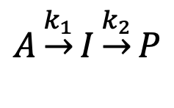
The “bucket” analogy
(simple two-step reaction)
k₁ - size of hole
Reservoir A
$$A\underset{→}{k_{1}}I\underset{→}{k_{2}}P$$
[A]
k₁ x [A]: rate of water flowing into bucket
[I] : level of water in bucket
Bucket I
k₂ - size of hole
k₂ x [I]: rate of water flowing out of bucket
Pond

Slide 10
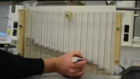
https://youtu.be/ZUzgVZk7Yxk?si=Y0DZBTpHNuC_OHif

Slide 11
What does the analogy tell us?
The level of water in the bucket initially increases, but quickly reaches a “steady state”
At steady state, (rate of water flowing in) = (rate of water flowing out)
The steady state level of water increases with rate flowing in (either because more water in A, or because the hole k₁ is larger)...
…and decreases with rate constant for water flowing out (if hole k₂ is larger)

Slide 12
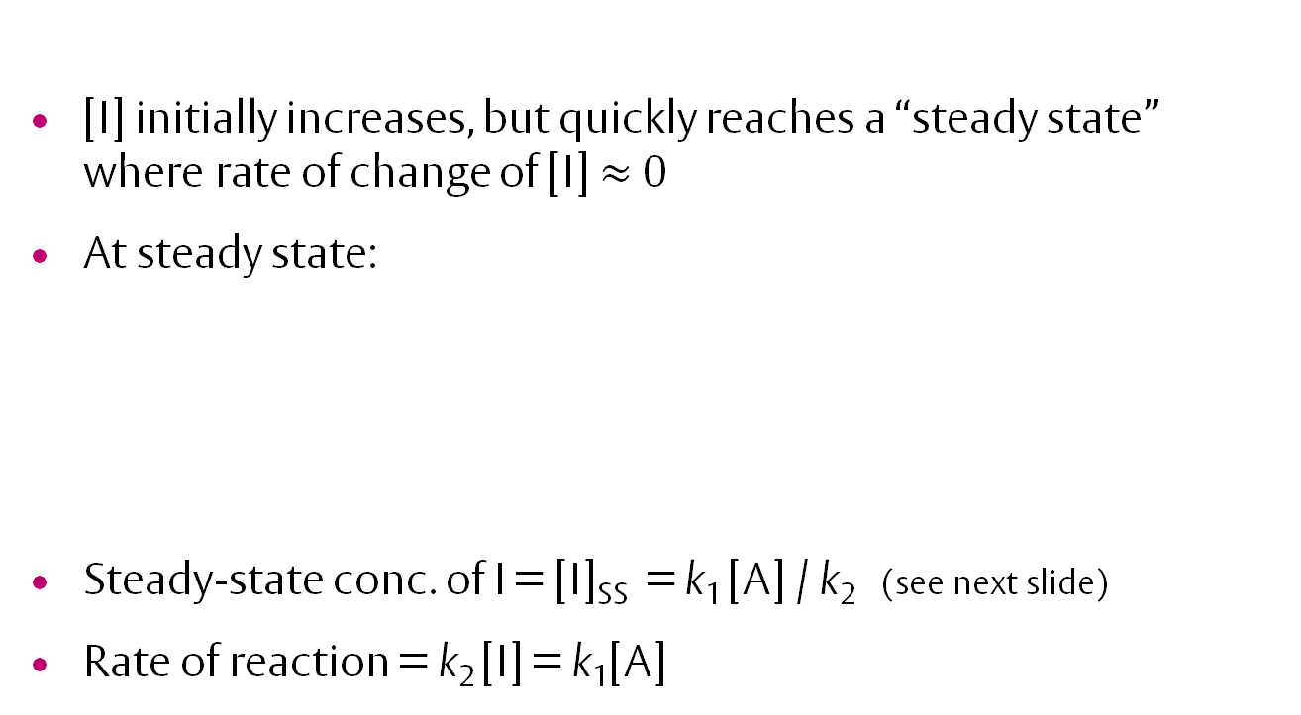

Steady state in chemical kinetics
$$A\underset{→}{k_{1}}I\underset{→}{k_{2}}P$$
[I] initially increases, but quickly reaches a “steady state” where rate of change of [I] $≈$ 0
At steady state:
Steady-state conc. of I = [I]_{SS} = k₁ [A] / k₂ (see next slide)
Rate of reaction = k₂ [I] = k₁[A]
Rate of process forming intermediate
Rate of process removing intermediate
=
k₁ × [A]
k₂ × [I]

Slide 13


How to apply the steady-state approximation
$$A\underset{→}{k_{1}}I\underset{→}{k_{2}}P$$
Write rate equations
Identify intermediate(s) and identify processes that produce and remove the intermediate
Combine to give overall rate of change of [intermediate]
Rate₁ = k₁ [A]
Rate₂ = k₂ [I]
$$A\underset{→}{k_{1}}I\underset{→}{k_{2}}P$$
Formed by step 1
Removed by step 2
Overall rate of change of [I]
d[I]/dt = Rate₁ – Rate₂
d[I]/dt = k₁[A] – k₂[I]

Slide 14
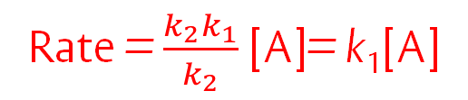
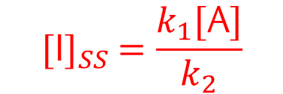
Apply steady-state approximation, rate of change of [intermediate]=0; solve to find [intermediate]_{SS}
Write rate law for elementary step that forms final products
Substitute [I] into (5) to get final rate
Overall rate of change of [I]
= d[I]/dt = k₁[A] – k₂[I] ≈ 0
k₂ [I]_{SS} = k₁ [A]
$${[\text{I}]}_{SS} =\frac{k_{1}[\text{A}]}{k_{2}}$$
Rate = d[P]/dt = Rate₂ = k₂ [I]
Rate = $\frac{k_{2}k_{1}}{k_{2}}$ [A]= k₁[A]

Slide 15

Worked example: How to apply the steady-state approximation
$$2A\underset{→}{k_{1}}I\underset{→}{k_{2}}P$$
Write rate equations
Identify intermediate(s) and identify processes that produce and remove the intermediate
Combine to give overall rate of change of [intermediate]

Slide 16

Worked example: How to apply the steady-state approximation
$$2A\underset{→}{k_{1}}I\underset{→}{k_{2}}P$$
Write rate equations
Identify intermediate(s) and identify processes that produce and remove the intermediate
Combine to give overall rate of change of [intermediate]
Rate₁ = k₁ [A]²
Rate₂ = k₂ [I]
$$2A\underset{→}{k_{1}}I\underset{→}{k_{2}}P$$
Formed by step 1
Removed by step 2
Overall rate of change of [I]
d[I]/dt = Rate₁ – Rate₂
d[I]/dt = k₁[A]² – k₂[I]

Slide 17
Apply steady-state approximation, rate of change of [intermediate]=0; solve to find [intermediate]_{SS}
Write rate law for elementary step that forms final products
Substitute [intermediate] into (5) to get final rate

Slide 18
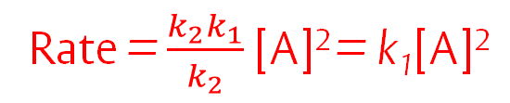
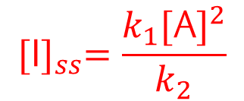
Apply steady-state approximation, rate of change of [intermediate]=0; solve to find [intermediate]_{SS}
Write rate law for elementary step that forms final products
Substitute [intermediate] into (5) to get final rate
Overall rate of change of [I]
= d[I]/dt = k₁[A]² – k₂[I] ≈ 0
k₂[I]_{SS} = k₁[A]²
$${[\text{I}]}_{ss}=\frac{k_{1}{[\text{A}]}^{2}}{k_{2}}$$
Rate = d[P]/dt = Rate₂ = k₂[I]
Rate = $\frac{k_{2}k_{1}}{k_{2}}$ [A]² = k₁[A]²

Slide 19
steady state – with reversible first step
CH2PH2 Chemical Kinetics

Slide 20
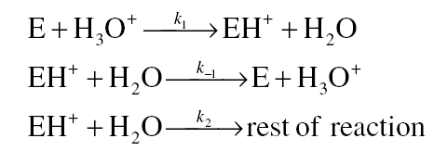
Reversible first step
Acid-catalysed hydrolysis of esters:
k₁
k₂
E + H₃O⁺
EH⁺ + H₂O
Products
k₋₁
(Step 1)
(Step -1)
(Step 2)
Rate equations for three steps are
Rate₁= k₁ [E][H₃O⁺] Rate₋₁ = k₋₁[EH⁺][H₂O] Rate₂ = k₂[EH⁺][H₂O]
2. Intermediate is protonated ester, EH⁺. This is formed by (1), removed by (-1) and (2).
3. Overall rate of change of intermediate d[EH⁺]/dt = Rate₁ – Rate₋₁ – Rate₂
Substitute in rates: d[EH⁺]/dt = k₁ [E][H₃O⁺] –k₋₁[EH⁺][H₂O] – k₂[EH⁺][H₂O]
(…continued…)

Slide 21
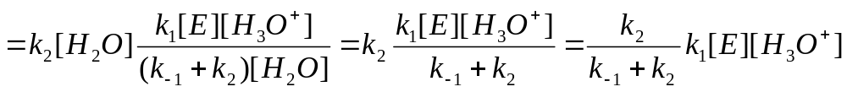
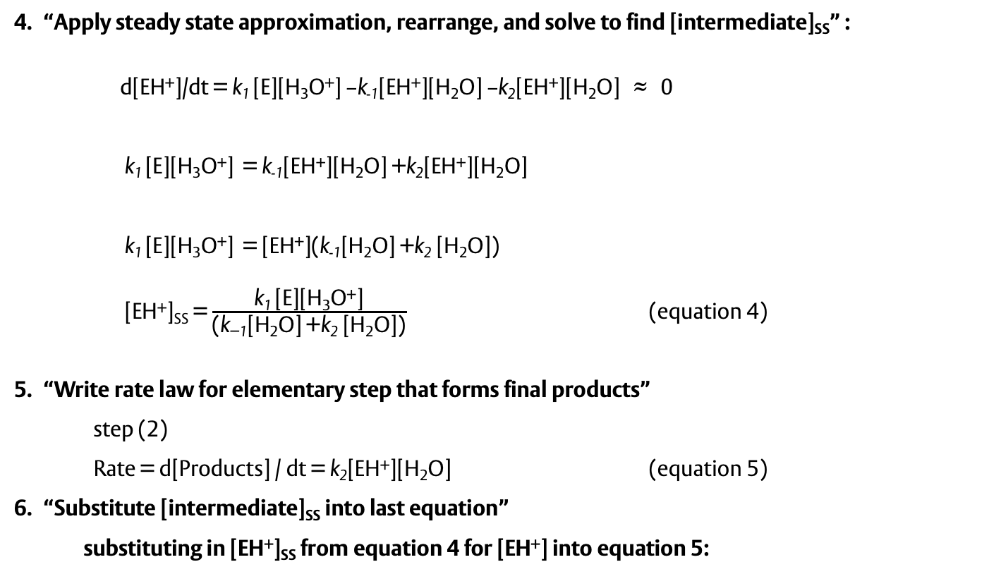
“Apply steady state approximation, rearrange, and solve to find [intermediate]_{SS}” :
d[EH⁺]/dt = k₁ [E][H₃O⁺] –k₋₁[EH⁺][H₂O] –k₂[EH⁺][H₂O] ≈ 0
k₁ [E][H₃O⁺] = k₋₁[EH⁺][H₂O] +k₂[EH⁺][H₂O]
k₁ [E][H₃O⁺] = [EH⁺](k₋₁[H₂O] +k₂ [H₂O])
[EH⁺]_{SS} = $\frac{\text{k}\text{1 }\text{[}\text{E}\text{][}\text{H}\text{3}\text{O}\text{+}\text{]}}{\text{(}\text{k}\text{−1}\text{[}\text{H}\text{2}\text{O}\text{] +}\text{k}\text{2}\text{ [}\text{H}\text{2}\text{O}\text{])}}$ (equation 4)
“Write rate law for elementary step that forms final products”
    step (2)
    Rate = d[Products] / dt = k₂[EH⁺][H₂O] (equation 5)
“Substitute [intermediate]_{SS} into last equation”
  substituting in [EH⁺]_{SS} from equation 4 for [EH⁺] into equation 5:
d[Products]/dt

Slide 22
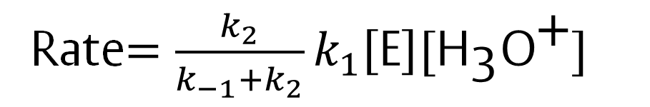
So, overall:
Rate is a fraction of k₁[E][H₃O⁺], which is Rate₁
  In this case, depends only on the ratio of k₂ and k₋₁ .
  eg. If k₂ = k₋₁, Rate = (1/2) × k₁[E][H₃O⁺] regardless of the values of k₂ and k₋₁
Rate$=\frac{k_{2}}{k_{−1}+k_{2}}k_{1}\left[\text{E}\right][{\text{H}}_{\text{3}}{\text{O}}^{\text{+}}]$

Slide 23
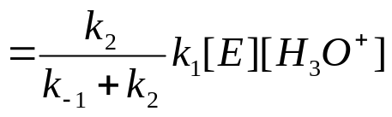




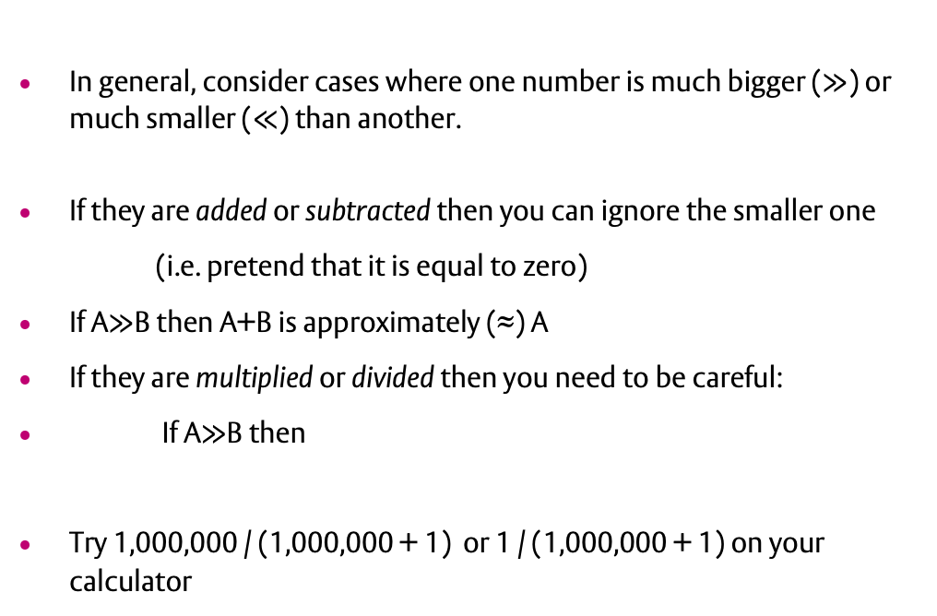
Limiting cases
Rate
What if k₂ is much smaller or larger than k₋₁?
In general, consider cases where one number is much bigger ($≫$) or much smaller ($≪$) than another.
If they are added or subtracted then you can ignore the smaller one
(i.e. pretend that it is equal to zero)
If A$≫$B then A+B is approximately (≈) A
If they are multiplied or divided then you need to be careful:
If A$≫$B then
Try 1,000,000 / (1,000,000 + 1) or 1 / (1,000,000 + 1) on your calculator
≈
≈

Slide 24
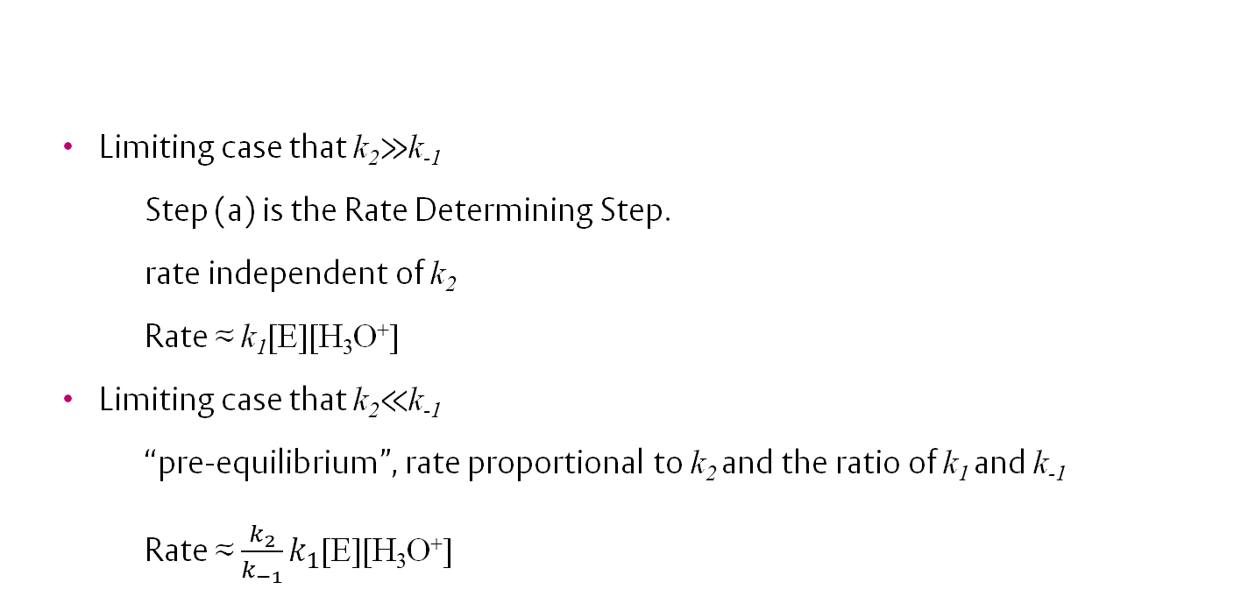
Limiting cases
  Limiting case that k₂$≫$k₋₁
  Step (a) is the Rate Determining Step.
  rate independent of k₂
    Rate ≈ k₁[E][H₃O⁺]
  Limiting case that k₂$≪$k₋₁
  “pre-equilibrium”, rate proportional to k₂ and the ratio of k₁ and k₋₁
    Rate ≈ $\frac{k_{2}}{k_{−1}}k_{1}$[E][H₃O⁺]
Rate

Slide 25
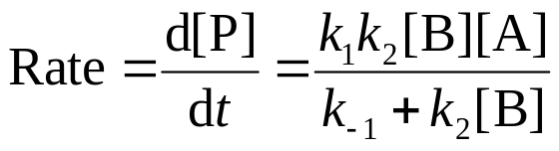
Another example (your task)
The reaction whose overall equation is
A + B → P proceeds via the following mechanism:
  k₁
  A → I
  k₂
  k₋₁
  I + B → P
  I → A
  (a) Show that the expected overall rate law is:

Slide 26
Your task (continued)
  (b) Consider the case where k₁ =k₂ =k₋₁ and [A] = 1
  Suppose that [B] is very small. What is the Rate when [B] = 0.01? 0.02? 0.03? What is the approximate order with respect to B under these conditions?
  Suppose that [B] is very big. What is the Rate when [B] = 100? 200? 300? What is the approximate order with respect to B under these conditions?
(c) By setting k₂ [B]>>k₋₁ or k₂ [B]<< k₋₁ in the Rate law from the previous slide, derive simplified rate laws for two limiting cases. Do they agree with your answers to (b)?
(d) Plot a graph of Rate against [B]

Slide 27
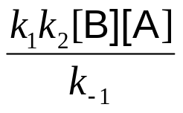
Answers
If k₂ [B]>>k₋₁ then d[P]/dt ≈ k₁[A]
(zero order w.r.t. [B])
If k₂ [B]<<k₋₁ then d[P]/dt ≈
(first order w.r.t. [B])
rate
[B]

Slide 28
Learning Outcomes
Today we have:
Practiced solving multi-step reactions
Introduced and applied the steady state approximation
Introduced the concept of reversibility in kinetics equations
Introduced the concept of limiting cases, and how the modify rate equations

